Slide 1


SDGs Ideation Session
A Social-Impact Hackathon

Slide 2
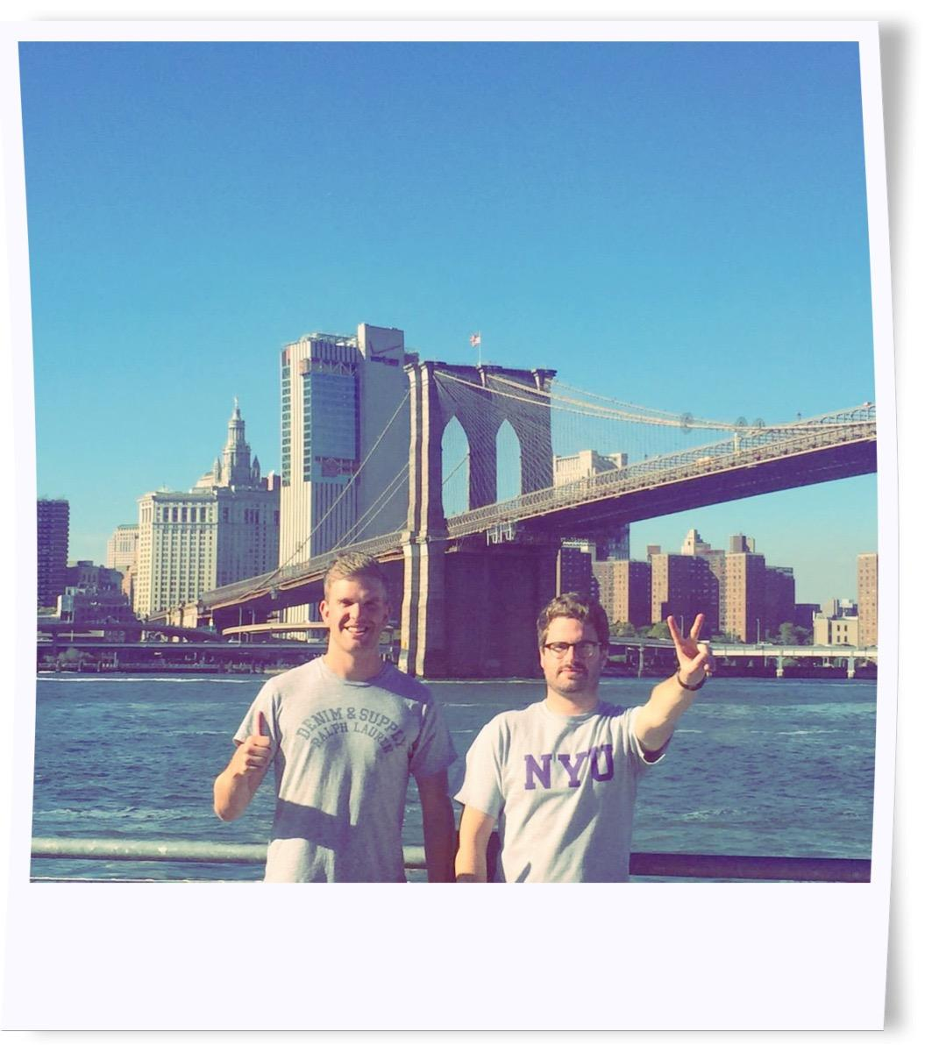
TIM HEARD
@TJRHD TIM HEARD
DAVID SPEARS
@DAVIDJSPEARS DAVID J SPEARS
A
D
A
D
tim & David

Slide 3
WHAT IS SOCIAL INTRAPRENEURSHIP?
AN INTRODUCTION TO THE CIRCLE
UN SDG IDEATION

Slide 4
WHAT IS A SOCIAL INTRAPRENEUR?

Slide 5
social intrapreneur
[noun]: soh-shuh-l in-truh-pruh-nur
A PASSIONATE INDIVIDUAL, WHO THINKS AND ACTS LIKE A ENTREPRENEUR, WORKING INSIDE A MAJOR CORPORATION OR ORGANISATION, WHO DEVELOPS AND DELIVERS INNOVATIVE, PROFITABLE AND SUSTAINABLE SOLUTIONS TO SOCIAL OR ENVIRONMENTAL CHALLENGES

Slide 6



























WELCOME TO THE CIRCLE OF YOUNG INTRAPRENEURS!
HELLO!
WE ARE A MOVEMENT DESIGNED TO INSPIRE, GUIDE, DEVELOP AND DELIVER PURPOSE-DRIVEN BUSINESS IDEAS FROM YOUNG SOCIAL INTRAPRENEURS IN LARGE, CORPORATE ORGANISATIONS GLOBALLY. WE’RE MAKING BUSINESS A FORCE FOR GOOD.
WHO
WE
ARE
CIRCLEOFYI.COM
@CIRCLEOFYI
WE LAUNCHED IN JANUARY 2016 IN LONDON, UK
AND NOW
WE HAVE
1000+ MEMBERS
IN
40+ COUNTRIES
FROM
300+
ORGS
JOIN
US
=
with 10 hubs globally
#1
WE ARE ALREADY THE LARGEST NETWORK OF SOCIAL INTRAPRENEURS ANYWHERE…
SOUND GOOD?
made by @davidjspears © circle of young intrapreneurs 2016

Slide 7

UN Sustainable Development Goals

Slide 8

CHOOSE A UN SDG
HOW CAN YOUR CORPORATE HELP COMBAT A
SOCIETAL NEED OR PROBLEM?
THINK ABOUT YOUR
STRATEGIC INITIATIVES
HOW CAN WORKING WITH
A SOCIAL LENS
DRIVE THIS?
COLLABORATE
HOW CAN YOU AND YOUR
GROUP MEMBERS WORK
TOGETHER ON THIS
CHALLENGE?
SHARE IT - WHAT’S THE IDEA?
WHAT’S THE COMMERCIAL,CUSTOMER/CLIENT AND SOCIETAL BENEFIT?

Slide 9
JOIN US
WWW.CIRCLEOFYI.COM
@CIRCLEOFYI

